Slide 1

Internet of Things - IT 4030
SMART GAS EMISSION PROTECTOR
R.M.A.Maduwantha
IT19979892

Slide 2

Introduction About System
This System mainly focus on about gas emission. In here this system can identify any gas leak of the area and if gas level across the danger level, the system notifies it Using SMS. after as the solution if it is not an open area, we can open the windows or doors using this system. Then we can reduce risk of the gas leak.

Slide 3

Tools
MQ2 Gas Sensor
Servo Motor
Buzzer
Resistor
ESP 32

Slide 4
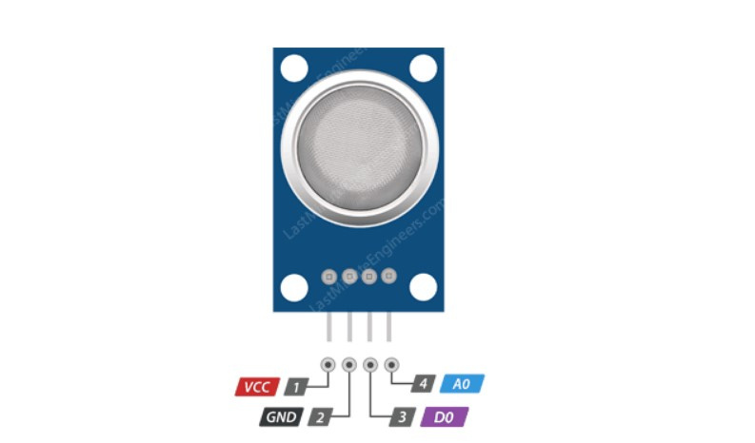

MQ2 Gas Sensor
The MQ2 gas sensor operates on 5V DC and consumes approximately 800mW. It can detect LPG, Smoke, Alcohol, Propane, Hydrogen, Methane and Carbon Monoxide concentrations ranging from 200 to 10000 ppm.

Slide 5
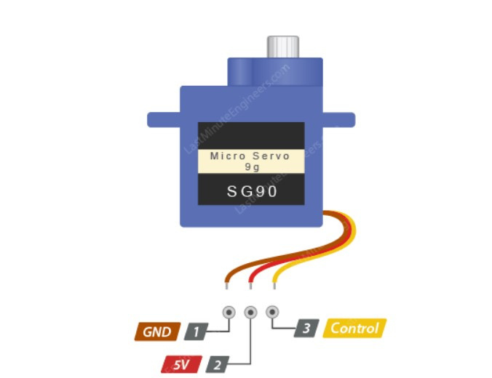
Servo Motor
Servo motors are great devices that can turn to a specified position. Usually, they have a servo arm that can turn 180 degrees.

Slide 6
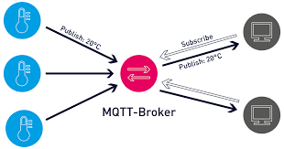
MQTT (Blynk)

Slide 7
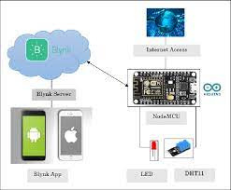
How Blynk Work

Slide 8
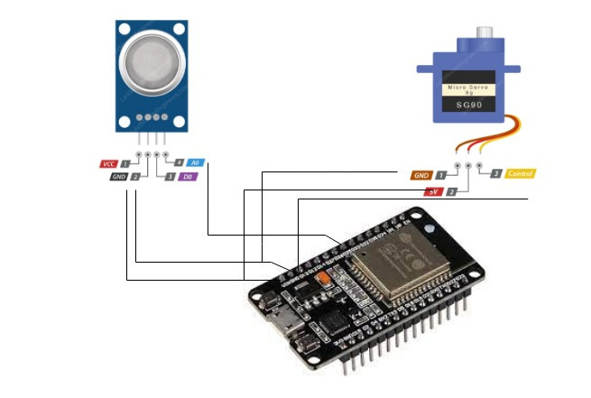
System overall Diagram

Slide 9
Thank You!!!

